Slide 1
Real-time Operating System
(RTOS)
Week 10
Department of software engineering
Faculty of Computing
UTM

Slide 2
Introduction
WHAT is RTOS
RTOS vs Generic OS
RTOS structure
RTOS services
RTOS examples
Micrium μc/OS II
Assessment
SCSJ 4423 – Real-time Software Engineering

Slide 3
WHAT is RTOS?
APPLICATION
“RTOS provides an "abstraction layer" that hides from application software the hardware details of the processor (or set of processors) upon which the application will run”
RTOS
HARDWARE
“In the development of real-time embedded systems, the use of a RTOS will increase the software productivity and improve the performance of the real-time system”
SCSJ 4423 – Real-time Software Engineering

Slide 4
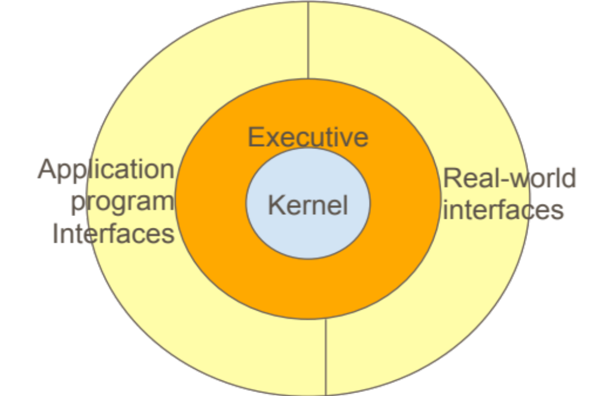
RTOS vs Generic OS?
RTOS ability to schedule tasks on the basis of external events, which are signaled to the computer by interrupts
RTOS is that their command interpreters are usually rather simple and they do not include many utility programs
RTOS Deterministic timing behavior in RTOS using mathematical formulas used to provide the service time must strictly algebraic & not include random timing components to avoid delay & miss deadlines.
The goal of RTOS is usually to serve the system it controls rather than human users
SCSJ 4423 – Real-time Software Engineering

Slide 5
RTOS structure?
KERNEL
Provide detailed facilities to the executive and called by the executive: executive behaves as the manager & kernel as the executor.
EXECUTIVE
The overall controller of all computer programs and directly controls all scheduling, mutual exclusion, data transfer and synchronization activities.
SCSJ 4423 – Real-time Software Engineering

Slide 6
RTOS services
Handling OS schedule
Organizing hardware
device
Handling OS mutual exclusion
Handling OS event and
interupt
Handling OS RAM
Handling OS time-related
Issues; delays, time-out,
Deadline,etc
SCSJ 4423 – Real-time Software Engineering

Slide 7
RTOS services
TASK MANAGEMENT
This set of services allows application software developers to design their software as a number of separate "chunks" or “task”of software
The main RTOS service in this category is the scheduling of tasks as the embedded system is in operation.
Controls the execution of application software tasks, and can make them run in a very timely and responsive fashion.
DYNAMIC MEMORY ALLOCATION
allows tasks to "borrow" chunks of RAM memory for temporary use in application software. The memory are then passed from task to task, as a means of quickly communicating large amounts of data between tasks.
very small RTOS kernels that are intended for tightly memory-limited environments, do not offer this service.
INTERTASK COMM. & SYNC.
It possible for tasks to pass information from one to another, without danger of that information ever being damaged.
They also make it possible for tasks to coordinate, so that they can productively cooperate with one another.
SCSJ 4423 – Real-time Software Engineering

Slide 8
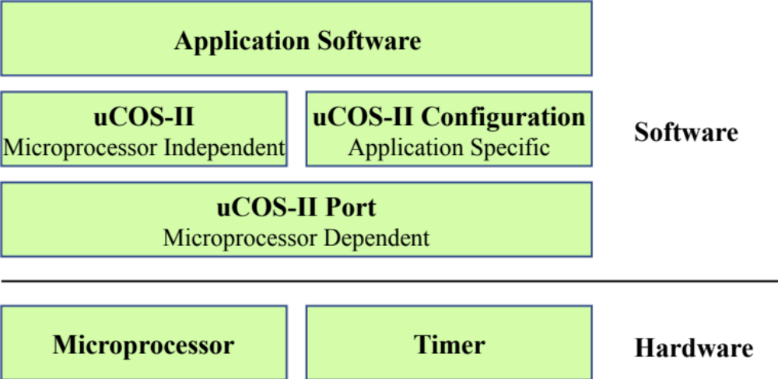
mC/OS-II Architecture
PORT – adapting mC/OS-II to the specific processor
You must have a C compiler for the processor and the C compiler must be able to produce reentrant code.
You must be able to disable and enable interrupts from C.
The processor must support interrupts and you need to provide an interrupt that occurs at regular
intervals (typically between 10 to 100 Hz).
The processor must support a hardware stack, and the processor must be able to store a fair amount of data
on the stack (possibly many Kbytes).
The processor must have instructions to load and store the stack pointer and other CPU registers either on
the stack or in memory.
SCSJ 4423 – Real-time Software Engineering

Slide 9
mC/OS-II Architecture features
Can be ported to any device
8,16,32,64 bit
Features
Portable
ROMable
Source code
Scalable
Preemptive multitasking
Deterministic
Task stacks
Interrupt management
Robust and reliable
Can handle up to 255 levels deep
All are provided
Can choose which service to use
Can handle interupt
Execution timing is predictable
SCSJ 4423 – Real-time Software Engineering

Slide 10
RTOS comparison
SCSJ 4423 – Real-time Software Engineering

Slide 11

Thank You
SCSJ 4423 – Real-time Software Engineering

Slide 12

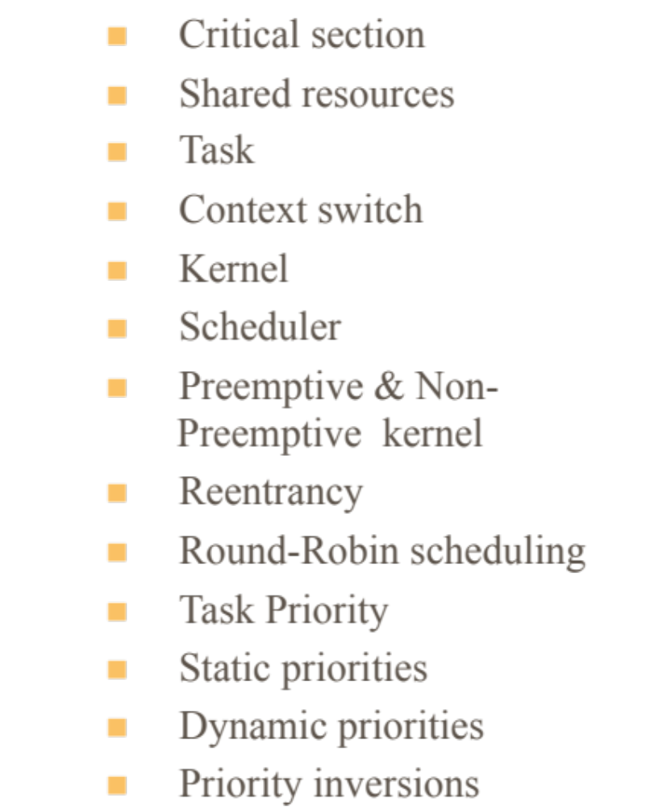
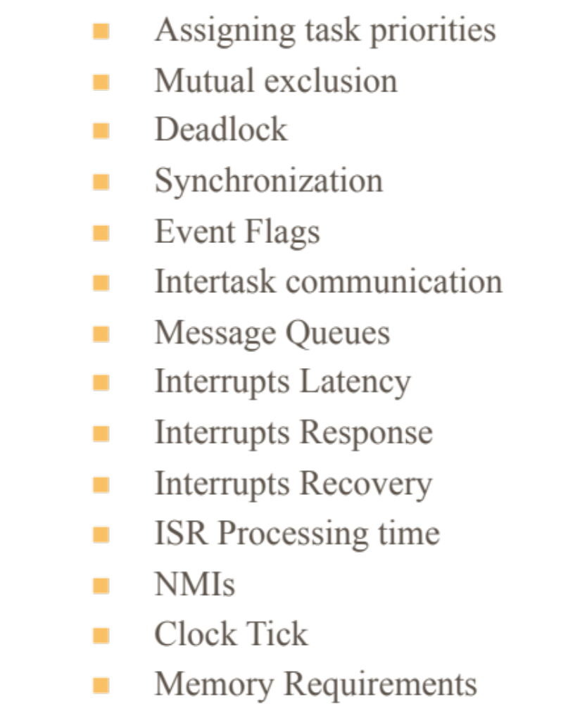
Group exercise
SCSJ 4423 – Real-time Software Engineering

